Slide 1
Conceptual data modelling
What do you think this diagram means?
Class
Key
Entity
One-to-one (1:1) relationship
One-to-many (1:n) relationship
Many-to-one (n:1) relationship
Many-to-many (m:n) relationship
…
Personal Details
Student
Attendance
Conduct Points

Slide 2
Conceptual data modelling
Conceptual data model: A representation of data requirements that is independent of software used to construct the database.
To achieve this we begin by establishing the entities and their relationships i.e. Entity Relationship modelling.

Slide 3
Entity Relationship modelling
An entity is any object/person/thing about which data
needs to be recorded, usually identified with a noun.
A relationship is identified by a line between two entities.
There are four possible degrees of relationship:
One-to-one (1:1)
One-to-many (1:n)
Many-to-one (n:1)
Many-to-many (m:n)
Student

Slide 4
Relationships: one-to-one
Can you identify the entities in this scenario?
B. Jones
A. Gray
Ford
Punto
Employee
Company Car
drives
In this scenario only one employee can drive one company car so the relationship is one-to-one. This is called the degree of a relationship.
This is shown by drawing a single line between the entities.
Each relationship must be given a name which is a verb to describe the link e.g. drives.

Slide 5
Relationships: One-to-many
Can you identify the entities in this scenario?
Doctor
Patient
treats
In this scenario one Doctor can treat many patients.
The degree of this relationship is: one to Many
The relationship name is: treats
The link has one set of crows feet on the many side of the relationship.

Slide 6
Relationships: Many-to-many
A film may have many actors and each actor may act in many films.
Can you identify the entities in this scenario?
Actor
Film
Act
In this scenario many actors can act in many films.
The degree of this relationship is: Many to Many
The relationship name is: Act
The link has two crows feet on both sides of the relationship.

Slide 7
Task: Identify relationships
Do questions 1-3 of worksheet student_worksheet_database_entity_relationships

Slide 8
Many-to-many relationships
Most databases cannot directly implement many-to-many relationships, so we need to break problem this down further.
Lets look at the scenario where a student may enrol on many courses, and the course has many students enrolled.
Student
Course
Enrolled on

Slide 9
Many-to-many relationships
Aim: To add another entity and reduce the relationships to one-to-many.
Student
Course
Is enrolled on
Student
Course
Enrolment
makes
for

Slide 10
Peek at many-to-many entity data
Student
Course
Enrolment
makes
for
StudentID | Firstname | Surname
1 | Fred | Jones
2 | Catherine | Tate
CourseID | Name
1 | Biology
2 | Art
StudentID | CourseID
1 | 1
1 | 2
2 | 1
2 | 2
Note: We will take a closer look at how the IDs work later this lesson…

Slide 11
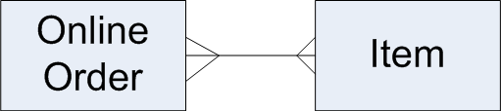
Task: convert many to many
How can this relationship be broken down?
Notes:
TODO check/challenge: Is it necessary to keep the many-to-many line in place after the many-to-many relation has been added? Need to know what AQA expects in exam answers for this, as different practices exist.

Slide 12
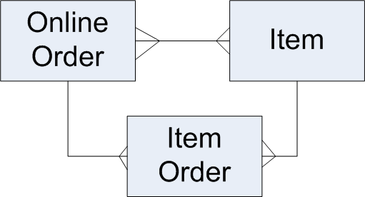
Task solution
Contains
Specifies
Contains

Slide 13
Relational Databases
A database is a structured collection of data.
Relational databases provide a structure that consists of entities (tables), attributes (fields/column) and tuples (rows).
This is the most widely used structure for databases, but other types of database do exist as well.

Slide 14
ERD notation
Capitalisation for table names.
Attributes in brackets.
Attributes all one word – capitals for first letters of EACH word.
Underline for keys
eg. STUDENT (StudentID, StudentName, YearStarted)

Slide 15
Types of keys
Primary Key: An attribute that uniquely identifies a tuple.
Composite Key: A combination of attributes that uniquely identify a tuple.
Foreign Key: an attribute in one table that is a primary key in another table.

Slide 16
Primary Keys
Every entity ought to have a primary key that uniquely identifies each tuple:
Customer
Customer ID
First Name
Surname
Address
City
Telephone number
Age
Gender
DVD Table
DVD ISBN No
DVD title
Certificate
Film Genre
Date Released
Length of film
Rental price
DVD Rentals Table
Rental ID
Date Rented
Date Returned

Slide 17
Example of keys
STUDENT(StudentID, FirstName, LastName)
COURSE(CourseID, CourseName)
ENROLMENT(StudentID, CourseID)
Which attributes do you think are: Primary Keys? Foreign Keys? Composite Keys?

Slide 18
Plenary
Revisit starter: Identify the relationships and keys in this example:
Class
CLASS ( )
STUDENT ( )
PERSONALDETAILS ( )
ATTENDANCE ( )
CONDUCTPOINTS ( )
( )
Personal Details
Student
Attendance
Conduct Points
Notes:
Teacher led exercise with magic pen.
Add in the relationships.
Break up the many-to-many relationship by adding another entity between Class and Student – also add this to the ERD notations.
Add in keys as attributes (other attributes unnecessary)

Slide 19
Plenary
One possible solution:
Class
CLASS ( ClassCode, … )
STUDENT ( StudentID, … )
PERSONALDETAILS ( ID, StudentID, …)
ATTENDANCE ( ID, StudentID, … )
CONDUCTPOINTS ( ID, StudentID, …)
ENROLMENT ( StudentID, ClassCode )
has members
Enrolment
is member
Personal Details
has
Student
Attendance
tracked
awarded
Conduct Points

Slide 20
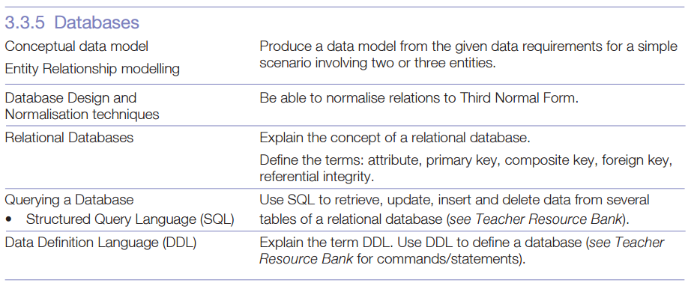
Specification Review

Slide 21
Prep: Complete the model
Complete Worksheet student_worksheet_entity_relationship_diagrams.docx and use ERD notation to describe one diagram on the worksheet.

Slide 22














Key words:
Noted clearly
Topic specific vocabulary wherever necessary
Icon for extension activity if appropriate
You might want to develop subject specific icons

